Slide 1

Convnets in TensorFlow
CS 20: TensorFlow for Deep Learning Research
Lecture 7
2/7/2017

Slide 3
Agenda
Convolutions without training
Convnet with MNIST!!!
tf.layers

Slide 4
Understanding convolutions

Slide 5
Convolutions in math and physics
a function derived from two given functions by integration that expresses how the shape of one is modified by the other

Slide 6
Convolutions in math and physics
Brian Amberg derivative work (Wikipedia)

Slide 7
Convolutions in math and physics
How an input is transformed by a kernel*
*also called filter/feature map

Slide 8
Convolutions in machine learning
We can use one single convolutional layer to modify a certain image

Slide 9
Convolutions in machine learning
http://deeplearning.stanford.edu/

Slide 10
Kernel for blurring
0.0625 | 0.125 | 0.0625
0.125 | 0.25 | 0.125
0.0625 | 0.125 | 0.0625
Matrix multiplication of this kernel with
a 3 x 3 patch of an image is a weighted sum of neighboring pixels
=> blurring effect
Notes:
Kind of blurring

Slide 11


Convolution without training
Kernel for blurring
0.0625 | 0.125 | 0.0625
0.125 | 0.25 | 0.125
0.0625 | 0.125 | 0.0625
tf.nn.conv2d
input
output
Notes:
Kind of blurring

Slide 12
Convolutions in TensorFlow
We can use one single convolutional layer to modify a certain image
tf.nn.conv2d(
input,
filter,
strides,
padding,
use_cudnn_on_gpu=True,
data_format='NHWC',
dilations=[1, 1, 1, 1],
name=None
)

Slide 13
Convolutions in TensorFlow
We can use one single convolutional layer to modify a certain image
tf.nn.conv2d(
input, Batch size (N) x Height (H) x Width (W) x Channels (C)
filter, Height x Width x Input Channels x Output Channels
strides, 4 element 1-D tensor, strides in each direction
padding, 'SAME' or 'VALID'
use_cudnn_on_gpu=True,
data_format='NHWC',
dilations=[1, 1, 1, 1],
name=None
)

Slide 14
Convolutions in TensorFlow
We can use one single convolutional layer to modify a certain image
tf.nn.conv2d(
image,
kernel,
strides=[1, 3, 3, 1],
padding='SAME',
)

Slide 15
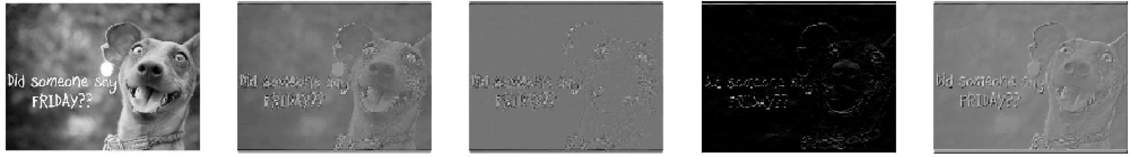
Some basic kernels
input
sharpen
edge
top sobel
emboss
See kernels.py and 07_run_kernels.py

Slide 16

Some basic kernels
input
sharpen
edge
top sobel
emboss

Slide 17
Convolutions in machine learning
Don’t hard-code the values of your kernels.
Learn the optimal kernels through training!

Slide 18
ConvNet with MNIST

Slide 19

Model
Maxpool (2x2x1)
Maxpool (2x2x1)
Fully + relu
Fully + softmax
28x28x1
Conv + relu
Conv + relu
28x28x32
14x14x32
14x14x64
7 x 7 x 64
1 x 1024
1 x 10
ŷ
5x5x1x32
5x5x32x64
7*7*64
x 1024
1024 x 10
Weight
Strides for all convolutional layers: [1, 1, 1, 1]

Slide 20
Convolutional layer
Maxpool (2x2x1)
Maxpool (2x2x1)
Fully + relu
Fully + softmax
28x28x1
Conv + relu
Conv + relu
28x28x32
14x14x32
14x14x64
7 x 7 x 64
1 x 1024
1 x 10
ŷ
5x5x1x32
5x5x32x64
7*7*64
x 1024
1024 x 10
Weight
conv = tf.nn.conv2d(images,
kernel,
strides=[1, 1, 1, 1],
padding='SAME')

Slide 21
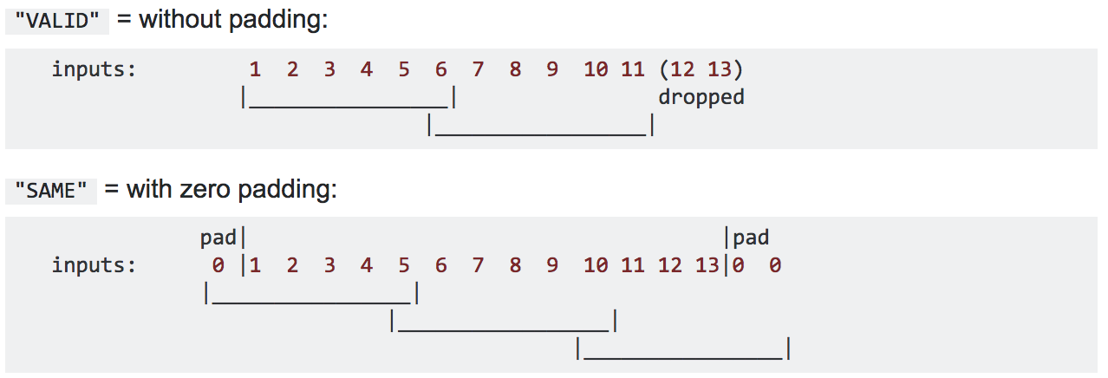
Convolutional layer: padding
Input width = 13
Filter width = 6
Stride = 5
Notes:
"VALID" only ever drops the right-most columns (or bottom-most rows).
"SAME" tries to pad evenly left and right, but if the amount of columns to be added is odd, it will add the extra column to the right, as is the case in this example (the same logic applies vertically: there may be an extra row of zeros at the bottom).

Slide 22
Convolutional layer: Dimension
Maxpool (2x2x1)
Maxpool (2x2x1)
Fully + relu
Fully + softmax
28x28x1
Conv + relu
Conv + relu
28x28x32
14x14x32
14x14x64
7 x 7 x 64
1 x 1024
1 x 10
ŷ
5x5x1x32
5x5x32x64
7*7*64
x 1024
1024 x 10
Weight
(W−F+2P)/S+ 1
W: input width /depth F: filter width/depth
P: padding S: stride

Slide 23
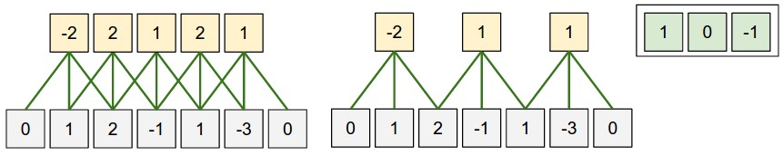
Convolutional layer: Dimension
(W−F+2P)/S+ 1
W: input width /depth F: filter width/depth
P: padding S: stride
Image credit: CS231n Lecture 7

Slide 24
Convolutional layer: Dimension
Maxpool (2x2x1)
Maxpool (2x2x1)
Fully + relu
Fully + softmax
28x28x1
Conv + relu
Conv + relu
28x28x32
14x14x32
14x14x64
7 x 7 x 64
1 x 1024
1 x 10
ŷ
5x5x1x32
5x5x32x64
7*7*64
x 1024
1024 x 10
Weight
(W−F+2P)/S+ 1
(28 - 5 + 2*2)/1 + 1 = 28
W: input width /depth F: filter width/depth
P: padding S: stride

Slide 25
Convolutional layer: Dimension
Maxpool (2x2x1)
Maxpool (2x2x1)
Fully + relu
Fully + softmax
28x28x1
Conv + relu
Conv + relu
28x28x32
14x14x32
14x14x64
7 x 7 x 64
1 x 1024
1 x 10
ŷ
5x5x1x32
5x5x32x64
7*7*64
x 1024
1024 x 10
Weight
(W−F+2P)/S+ 1
(28 - 5 + 2*2)/1 + 1 = 28
W: input width /depth F: filter width/depth
P: padding S: stride
TF computes padding for us!

Slide 26
Maxpooling
Maxpool (2x2x1)
Maxpool (2x2x1)
Fully + relu
Fully + softmax
28x28x1
Conv + relu
Conv + relu
28x28x32
14x14x32
14x14x64
7 x 7 x 64
1 x 1024
1 x 10
ŷ
5x5x1x32
5x5x32x64
7*7*64
x 1024
1024 x 10
Weight
pool1 = tf.nn.max_pool(conv1,
ksize=[1, 2, 2, 1],
strides=[1, 2, 2, 1],
padding='SAME')

Slide 27
Maxpooling
Single depth slice
1 | 1 | 2 | 4
5 | 6 | 7 | 8
3 | 2 | 1 | 0
1 | 2 | 3 | 4
x
max pool with
2x2 filters and stride 2
6 | 8
3 | 4
y
Slide credit: CS231n Lecture 7
Notes:
Can also do other ways of pooling, e.g. average pooling

Slide 28
Maxpooling: Dimension
Maxpool (2x2x1)
Maxpool (2x2x1)
Fully + relu
Fully + softmax
28x28x1
Conv + relu
Conv + relu
28x28x32
14x14x32
14x14x64
7 x 7 x 64
1 x 1024
1 x 10
ŷ
5x5x1x32
5x5x32x64
7*7*64
x 1024
1024 x 10
Weight
(W−K+2P)/S+ 1
W: input width /depth K: window width/depth
P: padding S: stride

Slide 29
Maxpooling: Dimension
Maxpool (2x2x1)
Maxpool (2x2x1)
Fully + relu
Fully + softmax
28x28x1
Conv + relu
Conv + relu
28x28x32
14x14x32
14x14x64
7 x 7 x 64
1 x 1024
1 x 10
ŷ
5x5x1x32
5x5x32x64
7*7*64
x 1024
1024 x 10
Weight
(W−K+2P)/S+ 1
(28 - 2 + 2*0) / 2 + 1 = 14
W: input width /depth K: window width/depth
P: padding S: stride

Slide 30
Fully connected
Maxpool (2x2x1)
Maxpool (2x2x1)
Fully + relu
Fully + softmax
28x28x1
Conv + relu
Conv + relu
28x28x32
14x14x32
14x14x64
7 x 7 x 64
1 x 1024
1 x 10
ŷ
5x5x1x32
5x5x32x64
7*7*64
x 1024
1024 x 10
Weight
fc = tf.matmul(pool2, w) + b

Slide 31
Softmax
Maxpool (2x2x1)
Maxpool (2x2x1)
Fully + relu
Fully + softmax
28x28x1
Conv + relu
Conv + relu
28x28x32
14x14x32
14x14x64
7 x 7 x 64
1 x 1024
1 x 10
ŷ
5x5x1x32
5x5x32x64
7*7*64
x 1024
1024 x 10
Weight
Loss function
tf.nn.softmax_cross_entropy_with_logits(labels=Y, logits=logits)
Predict
tf.nn.softmax(logits_batch)

Slide 32
Interactive coding
07_convnet_mnist_starter.py from GitHub!
Update utils.py

Slide 33
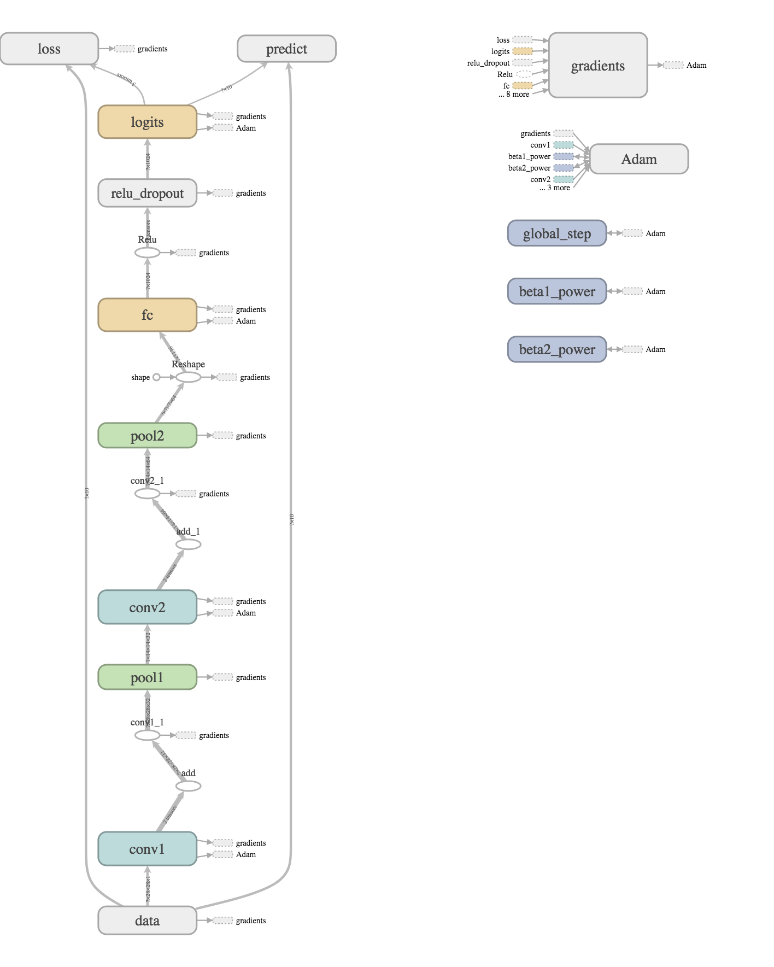

Slide 34
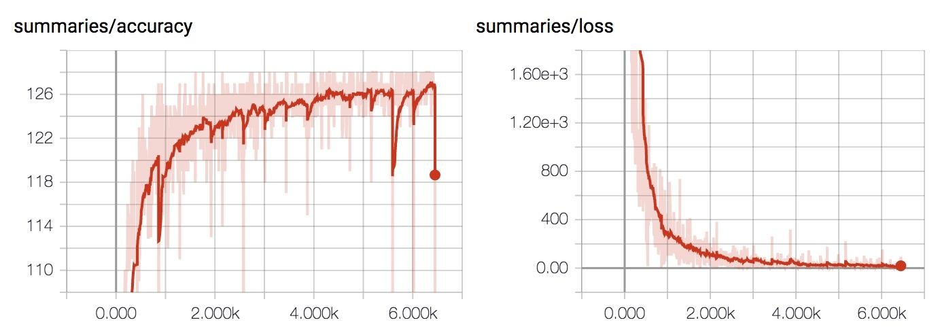
Training progress
Test accuracy increases while training loss decreases!

Slide 35
Accuracy
Epochs | Accuracy
1 | 0.9131
2 | 0.9363
3 | 0.9478
5 | 0.9573
10 | 0.971
25 | 0.9818

Slide 36
tf.layers

Slide 37
tf.layers
We’ve been learning it the hard way

Slide 38
tf.layers.conv2d
conv1 = tf.layers.conv2d(inputs=self.img,
filters=32,
kernel_size=[5, 5],
padding='SAME',
activation=tf.nn.relu,
name='conv1')

Slide 39
tf.layers.conv2d
conv1 = tf.layers.conv2d(inputs=self.img,
filters=32,
kernel_size=[5, 5],
padding='SAME',
activation=tf.nn.relu,
name='conv1')
can choose non-linearity to use

Slide 40
tf.layers.max_pooling2d
pool1 = tf.layers.max_pooling2d(inputs=conv1,
pool_size=[2, 2],
strides=2,
name='pool1')

Slide 41
tf.layers.dense
fc = tf.layers.dense(pool2, 1024, activation=tf.nn.relu, name='fc')
Notes:
Fully connected

Slide 42
tf.layers.dense
dropout = tf.layers.dropout(fc,
self.keep_prob,
training=self.training,
name='dropout')
Drop neurals during training
Want to use all of them during testing
Notes:
Fully connected

Slide 43
Next class
TFRecord
CIFAR
Style Transfer
Feedback: chiphuyen@cs.stanford.edu
Thanks!

